Slide 1
Visual suggestions
Project Pricing

Slide 2
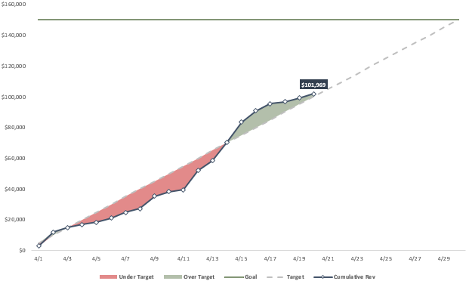
Bidding overall
# projects
Value: Number of projects
Total spend
Value: total spend this year
Total volume purchased
Value: total volume this year
Total saving
Value: total saving this year
Total projects having loss
Value: total project having loss
Cost Saving progress
Horizontal axis: by Month
Vertical axis: Value
Chart type: customized
Filter: Project code, Supplier
To view the progress of cost consumed during the time period of each project
Target is the estimated value based on BOQ price and material requirements.
Top Saving project
Combine: showing its total Project Value
Sort by Project Value or Project Saving
Horizontal value axis: Value
Vertical axis: Project code
Chart type: Bar chart
Filter: Time period, Project Location
Supplier price comparison
Horizontal axis: by Month
Vertical axis: Average price of Supplier or Latest approved price
(ví dụ, 1 Jan approve giá x, đến 2 May mới có giá y, thì during Jan – May, giá x được thể hiện)
Chart type: Line chart
Filter: Project code, Item code or Item category
To view the price fluctuation versus target price (market price or BOQ)
Item price fluctuation
Horizontal axis: by Month
Vertical axis: Average price of item or Latest approved price
(ví dụ, 1 Jan approve giá x, đến 2 May mới có giá y, thì during Jan – May, giá x được thể hiện)
Chart type: Line chart
Filter: Project code, Supplier
To view the price fluctuation versus target price (market price or BOQ)
Note:
Đối với dữ liệu giá, chọn lấy giá quoted hoặc giá approved (subject to user’s choice).
Trong dữ liệu giá, nếu tháng 1 có giá, tháng 2 3 4 không có thì apply giá tháng 1 (vì giá đi theo Valid date). Nếu tháng 1 có trên 1 lần giá, thì lấy trung bình giá.
Tuy nhiên, concern ở chỗ nếu tầm giữa tháng hay cuối tháng mới có giá, vậy thì giá này có tính là giá của tháng không? Hay chia tỷ lệ để lấy Weighted Average?
2
Notes:
Saving in Project price:
(Average of Non-Awarded Bids - Awarded Bid) = Savings
(BOQ – Awarded Bid) = Savings

Slide 3
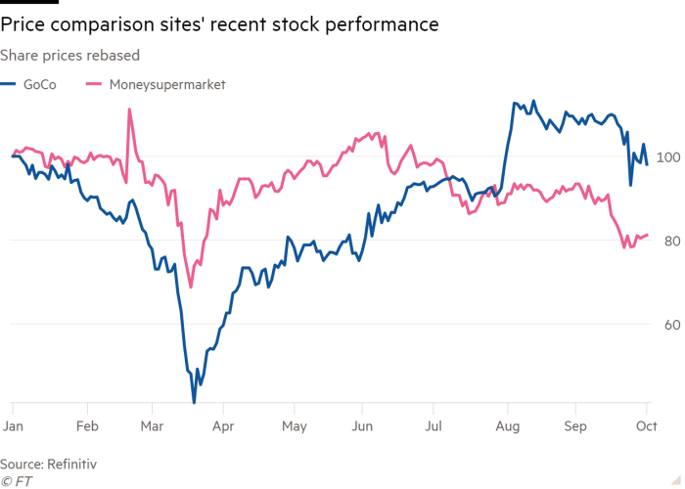
Bidding ITEM profiling
# items
Value: Number of items
Total spend
Value: total spend this year
Total volume purchased
Value: total volume this year
Average price this year
Value: avg price of items (vs market or BOQ price)
Total saving
Value: total saving this year
Top Coverage
Value axis: Number of suppliers
Category axis: Item or Category
Chart type: Bar chart
Filter: Time period, Project Location
Should choose Item Category i/o item differentiated by specification (eg, Xi mang i/o Xi mang xam)
Top Volume
Value axis: Total volume
Category axis: Item or Category
Chart type: Bar chart
Filter: Time period, Project Location
Top Amount (Spend)
Value axis: Total spend
Category axis: Item or Category
Chart type: Bar chart
Filter: Time period, Project Location
Formula: Price x Quantity (Price at each time period multiply with Volume purchased during that period)
Item positioning
Horizontal value axis: Value
Vertical value axis: # of suppliers
Category: Item or Category
Chart type: Quadrant chart
Filter: Time period, Project Location
Price fluctuation by Item
Vertical axis (Value): Average price
Horizontal axis: Time (by month)
Chart type: Line chart (comparison)
Filter: Time period, Project Location, Supplier
Data:
Average price of item per all included suppliers during the time period
Benchmark: Average market price (price of all supplier quoted) or average BOQ price
Customization:
Under benchmark: green
Over benchmark: red
Top increase & its Amount
Value axis: Increase MOM or YOY
Category axis: Item
Combine to show Spend of item. Sort by Top %increase
Chart type: Bar chart/Combo chart
Filter: Time period, Project Location, Supplier
Data:
Average price of item per all included suppliers during the time period => %increase
Benchmark (if using): Average market price (price of all supplier quoted) or average BOQ price => % increase
Customization:
Under benchmark: green
Over benchmark: red
Saving by Item & Top Saving
Vertical axis (Value): Amount
Horizontal axis: Time (by month)
Chart type: Line chart (comparison among supplier)
Filter: Time period, Project Location, Supplier
Data:
Cost saving of item
Benchmark: Amount based on average market price (price of all supplier quoted) or BOQ price
Customization:
Less than 0: red
Over 0: green
- Or choose to visualize Top Saving Chart
3
Notes:
Saving in Project price:
(Average of Non-Awarded Bids - Awarded Bid) = Savings
(BOQ – Awarded Bid) = Savings

Slide 4
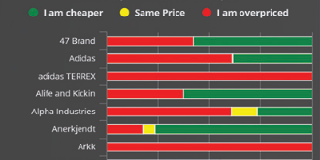
Bidding SUPPLIER profiling
# suppliers
Value: Number of suppliers
Total spend
Value: total spend this year
Total volume purchased
Value: total volume this year
Average price this year
Value: avg price of suppliers (vs market or BOQ price)
Total saving
Value: total saving this year
Top Coverage
Value axis: Number of items
Category axis: Supplier
Chart type: Bar chart
Filter: Time period, Item Category, Project Location
Stuck: how “unique” item is defined? By item code, or item code + brand + spec?
Top Volume
Value axis: Total volume
Category axis: Supplier
Chart type: Bar chart
Filter: Time period, Item Category, Project Location
Top Amount (Spend)
Value axis: Total spend
Category axis: Supplier
Chart type: Bar chart
Filter: Time period, Item Category, Project Location
Formula: Price x Quantity (Price at each time period multiply with Volume purchased during that period)
Supplier positioning
Horizontal value axis: Value
Vertical value axis: Volume
Category: Supplier
Chart type: Quadrant chart
Filter: Time period, Item Category, Project Location
Price positioning by Supplier
Vertical axis (Category label): Supplier
Horizontal axis: %
Chart type: 100% Stacked Bar chart
Filter: Time period, Item Category, Project Location
Data:
Average price of supplier by “unique” item during the time period
Average market price (price of all supplier quoted) or average BOQ price
Calculate % of items that supplier overprice or underprice
Decide tolerance to define “same price”
Customization:
Overpricing: red
Underpricing: green
Same: grey or light yellow
Price fluctuation by Supplier
Vertical axis (Value): Average price
Horizontal axis: Time (by month)
Chart type: Line chart (comparison)
Filter: Time period, Item Category, Project Location
Data:
Average price of supplier per all included item during the time period
Benchmark: Average market price (price of all supplier quoted) or average BOQ price
Note:
Decide to exclude the unmatched items among suppliers or include all items which having quotation?
Customization:
Under benchmark: green
Over benchmark: red
Saving by Supplier & Top Saving
Vertical axis (Value): Amount
Horizontal axis: Time (by month)
Chart type: Line chart (comparison among supplier)
Filter: Time period, Item Category, Project Location
Data:
Cost saving of supplier
Benchmark: Amount based on average market price (price of all supplier quoted) or BOQ price
Note:
Decide to exclude the unmatched items among suppliers or include all items which having quotation?
Customization:
Less than 0: red
Over 0: green
- Or choose to visualize Top Saving Chart
4
Notes:
Saving in Project price:
(Average of Non-Awarded Bids - Awarded Bid) = Savings
(BOQ – Awarded Bid) = Savings

